Slide 1

by Christopher B. Barrett, Thomas Reardon,
Johan Swinnen and David Zilberman
Seminar at the annual meetings of the
CGIAR Research Program on Policies, Institutions, and Markets
Washington, DC
October 28, 2019
Structural Transformation and Economic Development:
Insights from the Agri-food Value Chain Revolution

Slide 2
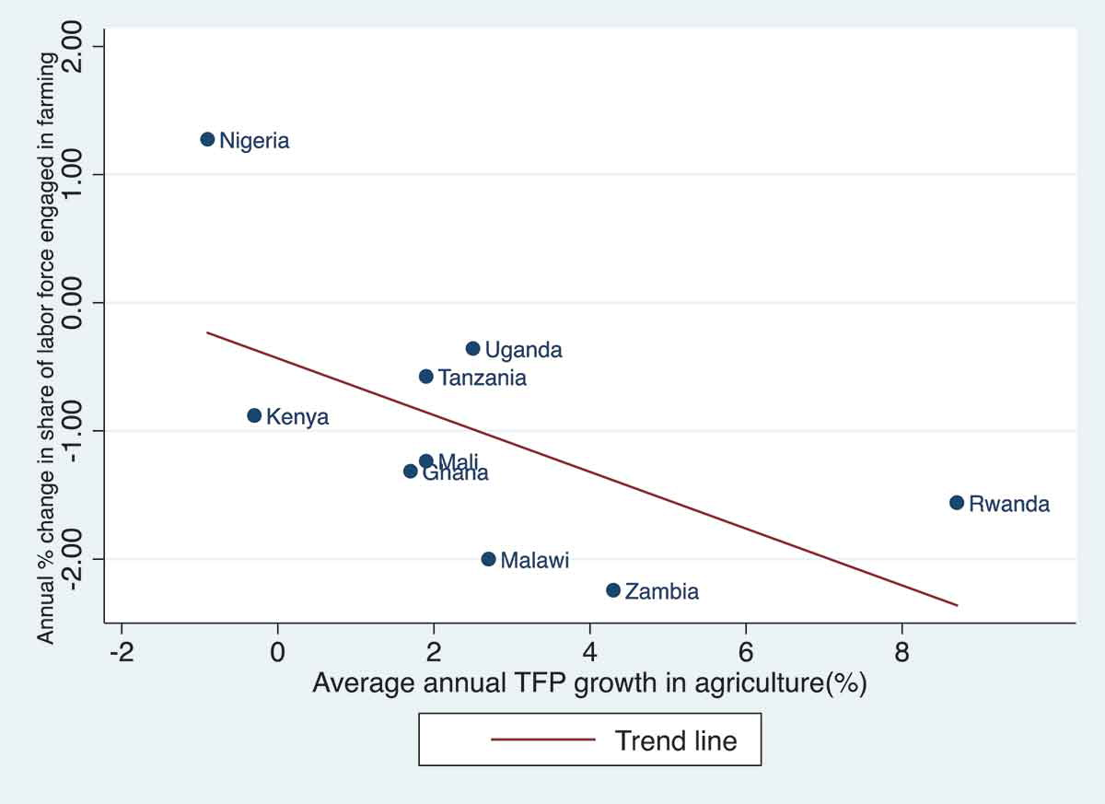
Structural transformation
The process of structural transformation involves:
Rising agricultural productivity boosts farm / non-farm incomes
Agriculture’s share of output and employment falls
Migration to non-farm sector and urban locations
Dietary/nutritional transition
Improved spatiotemporal and factor/product market integration
Typically captured by stylized 2 sector (dual economy – ag/industry) models …
that assume no intermediation nor value addition b/n farmers-consumers!
Source: Yeboah and Jayne JDS 2018

Slide 3
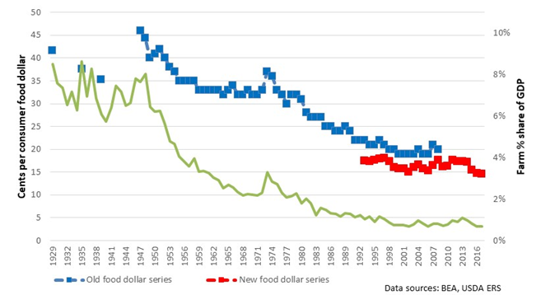
Structural transformation
Agri-food value chain central to structural transformation:
Increasingly distant food consumers with greater purchasing power
Seek more diverse diets and greater non-nutritive food attributes
Leads to a rapid rise in the post-harvest share of food expenditures.
US Farm Share of Consumer Food Expenditures and Gross Farm Value Added Share of GDP

Slide 4
Macro-scale drivers
So what exogenously drives agri-food value chain transformation?
Exogenous technological change boosts on-farm and post-harvest productivity (genetics, ICT, transport, electricity, etc.) and incomes
Population growth/urbanization leads to agglomeration economies
Shifting family structure, rising opportunity cost of consumer time
Implies:
Growing consumer demand for variety and non-nutritive attributes (convenience, packaging, preparation, safety, appearance, etc.)
Economic/geographic market expansion
Income/price elasticities of demand fall w/income growth
Firms profit most from processing, product differentiation, services provision, economies of scale/scope esp. for higher value food/FAFH

Slide 5
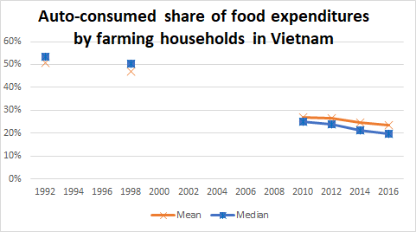
Macro-scale drivers
These patterns hold in rural as well as urban areas.
As farmers’ output and incomes increase, they buy a growing share of the food their families consume.
Data source: Liu et al. 2019

Slide 6
Macro-scale drivers
But urbanization has an especially strong impact b/c:
Longer distances to evacuate farm products to consumers
Need for cold chains, preservation, transport logistics
Urban incomes > rural incomes
And LMICs are urbanizing faster and differently than OECD:
In OECD: only Korea (3), Australia, Japan, US (2 each) have multiple cities ≥3 mn.
China > 30, India 10, Pakistan 5, Brazil, Egypt, Nigeria 3 each
The food supply chain challenge is notably greater in LMICs with heavier, less spatially dispersed urban gravitational pulls. We don’t yet really grasp the implications of this.

Slide 7
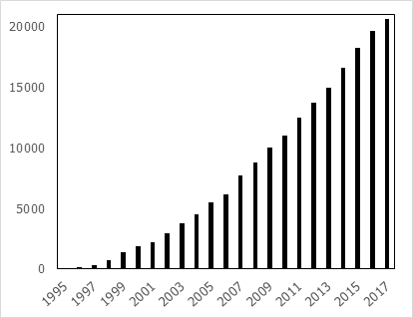
Macro-scale drivers
Policy reforms and institutional change:
State compression and market-oriented liberalization
Trade, FDI and intellectual property rights relaxation
Absence of strong competition/anti-trust policies
Comm/transport infrastructure advances build market scale
Rise of private and public standards
SPS notifications at the WTO (total) 1995-2017 (most growth from LMICs)

Slide 8
Micro drivers: profit-seeking supply chain innovation
Innovation in products, processes, markets:
Firms seek profits … innovate to reduce costs, boost productivity, or – best of all – secure temporary mkt power.
Product life cycle (Vernon):
  products typically launch in high price niche markets … market power of innovator temporarily sustains high prices and profits
  Technology improves, costs falls, knowledge diffuses, imitation/competition grows, market expands, profit margins fall
  As formerly-new products become commodities, firms differentiate the product, market, or both, seeking new market power and profits.

Slide 9
Micro drivers: profit-seeking supply chain innovation
African ag tech change
Product/process innovation is the main driver of value chain transformation.
Firms innovate to reduce costs, boost productivity, enter new mkts, or secure (temp) market power.
Much heterogeneity within supply chains … leads to non-random selection.
Firms vertically integrate, coordinate, or buy spot, as driven by context.

Slide 10
Micro drivers: profit-seeking supply chain innovation
African ag tech change
Dynamics and disequilibrium play a very large role … standard, equilibrium-based economic analysis misses much of the action!
Products, processes, prices and market structure/power co-evolve.
Learning is key to the innovation and diffusion process. Dynamics of learning naturally lead to S-shaped diffusion in time.
And dynamics of adoption of innovations leads to a “technology treadmill” for some … gains accrue unequally through value chain: to early adopters and suppliers in perfectly competitive markets (perfectly elastic demand, e.g., exports), and consistently to consumers downstream.

Slide 11
Challenges of empirical value chains research
Implications of conceptual model:
1) Multi-level, non-random placement and selection effects:
- firms, locations, farmers, etc.
2) Lots of selection on unobservables: innovativeness, networks, charisma, skill, reputation, etc.
3) Supply chain org (contracts, vertical org) is endogenous
4) Heterogeneous treatment effects
5) Unobservables imply heterogeneous treatments!

Slide 12
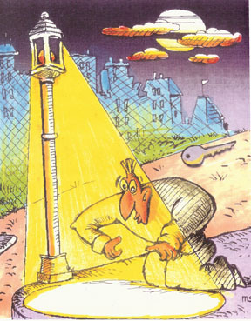
Challenges of empirical value chains research
Data:
Nat. rep. household surveys (e.g., DHS/LSMS) miss commercial enterprises
Nat. rep. enterprise surveys miss the informal sector
Surveys rarely match buyers- sellers, so don’t know all parties to exchange/coordination
Proprietary, firm-specific data s.t. placement/selection effects
Survivorship bias rampant
Image: https://larspsyll.files.wordpress.com/2014/07/ keyseaerch.jpg?w=550
Result: literature is rich in observational description, weak in robust causal inference.

Slide 13
African ag tech change
Empirical observations
Rapid growth of GVCs, esp. in high-value products s.t. grades and standards: especially fruits and vegetables, and animal-source foods, responding to growth in consumer demand globally
Fruit and Vegetable Exports, 1995-2016
(Current USD value, Indexed 1995=100)
Ag GVC exports heavily concentrated:
A few countries/region
A few commodities/ country (e.g., oranges or soy in Brazil, bananas or coffee in Colombia)
Bigger role of GVCs is in FDI/portfolio investment and diffusing innovations.

Slide 14
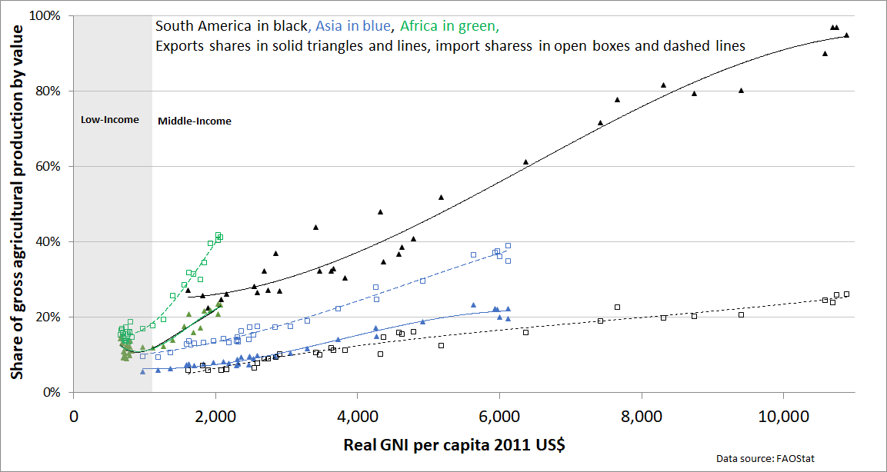
African ag tech change
Empirical observations
But low value/weight and perishability mean domestic market opportunities >> int’l trade. Globally, only 23% of food production is traded internationally. In low-income range, gross exports/imports consistently <20% of production.

Slide 15
African ag tech change
3 stages AVC transformation
1. Traditional stage
Predominantly rural and low-income populations
Mainly small, semi-subsistence producers using basic technologies
Periodic spot market exchange dominates
Weak comms/transport infrastructure w/low spatiotemporal integration
Traded foods mainly unprocessed, undifferentiated, non-perishables
Informal contracts enforced largely by reputational mechanisms

Slide 16
African ag tech change
3 stages AVC transformation
2. Transitional stage
Urbanization elongates value chains
Commercially oriented peri-urban producers emerge
Growing incomes drive demand for higher-value products
Public grades and standards begin to emerge
Post-harvest value addition (logistics, packaging, processing, wholesaling, retailing) increases rapidly
Contract farming emerges, J-curve in post-harvest concentration

Slide 17
African ag tech change
3 stages AVC transformation
3. Modern stage
Urban demand now drives entire value chain
Must reach further into countryside – cold chains, long haul transport
Private standards/differentiation proliferate and eclipse public ones
Non-nutritive attributes become important product attributes
Drives vertical integration and long-term contracting
Rapid growth in food away from home and in convenience processing/packaging for food retail
Capital intensity, FDI (esp. in 3PL) and labor productivity grow fast

Slide 18
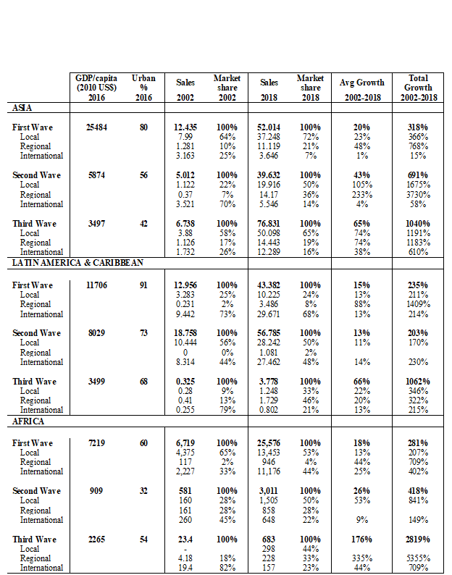
African ag tech change
3 post-harvest revolutions
1. Supermarket/retail revolution
Unprecedentedly rapid growth; multinationally FDI initially important but yields to local/regionals; regionals key in third wave markets.
Total edible grocery sales of leading retail chains in Africa, 2002-2018 (nominal USD mn)
Data source: www.Planetretail.net. First wave: Botswana, Namibia and South Africa. Second wave: Kenya, Madagascar, Malawi, Mozambique, Tanzania, Zambia , Zimbabwe. Third wave: Angola, Ghana, Nigeria, Senegal.

Slide 19
African ag tech change
3 post-harvest revolutions
2. Food services revolution
Unprecedentedly rapid growth; multinationally FDI initially important but yields to local/regionals; driven heavily by rising shadow wages and women entering workforce; capital-intensive; branding is key.
Gross sales leading café, fast food, restaurant chains in Africa, 2008-2018 (nominal USD mn)
Data source: retail food service chain-country pairs from www.Planetretail.net. Firms represented: Fast Food Restaurants: A&W All American Food; Baskin-Robbins; Burger King; California; Cold Stone Creamery; Domino's; Doña Tota; East Dawning; Harajuku Delights; KFC; Long John Silver's; McDonald's; Pizza Hut; Seaport; Subway; Taco Bell; Taco Bell Grande; Wendy's. Cafés: 85 degrees C; Au Bon Pain; Cafe Brio; Dunkin' Donuts; Pacific Coffee; Sanborns Café; Starbucks; Restaurants: Afternoon Tea; Applebee's; BHG Kitchen; Chili´s; IHOP; KAZOKUTEI; Little Sheep; LongHorn Steakhouse; Maxim's; Olive Garden; Red Lobster; Rock and Roll; S&R QSR; SHUN-NO-MAI; Super Quick; The Capital Grille; Vips.

Slide 20
African ag tech change
3 post-harvest revolutions
3. ‘Quiet’ revolution in intermediation/third-party logistics
Longer supply chains, stricter standards, greater capital-intensity put a greater premium on logistics and processing (e.g., transport, cold storage, preservation). Significant economies of scope/scale.
Behind the scenes 3PL firms drive lots of agri-food sector innovation in the modern stage.
Sysco, OSI, etc. – huge wholesalers/processors w/global reach; often launch in high-income markets, expand globally w/food service clients
Markets concentrate heavily and quickly; regionals often take over from multinationals.

Slide 21
African ag tech change
Evidence of impacts
Caution: heavy reliance on observational, non-representative data … rigorous causal inference is rare.
Technology transfer and diffusion:
Modernizing value chains typically associated w/:
upstream technology diffusion to farmers (irrigation, seed, fertilizer, etc.)
Improved on-farm and post-harvest management practices (e.g., storage, soils management) that spillover to other crops
Emergence of new products w/int’l tech transfer downstream (e.g., UHT milk, frozen beef patties)

Slide 22
African ag tech change
Evidence of impacts
Competition, concentration, market power:
Modernizing value chains typically associated w/:
Temporary market power is normal … that’s what firms seek!
J-curve in concentration ... Local mkt power gives way, but growing capital-intensity, IP, and branding re-concentrates.
In some settings, market power can be good, resolving other market failures … (theory of 2nd best)

Slide 23
African ag tech change
Evidence of impacts
Smallholder inclusion in value chains:
Modernizing value chains typically associated w/:
Very mixed evidence, as one would expect given optimal contract design
Huge selection and placement effects

Slide 24
African ag tech change
Evidence of impacts
Employment and labor market effects:
Modernizing value chains typically associated w/:
Higher on-farm labor demand
Significant growth in post-harvest value chain employment
Indeed, labor market effects swamp smallholder participation effects (e.g., Kenya veg sector: ~7K growers, 40-60K farm or processing or 3PL workers)
Labor productivity gains typically mean higher wages, too
Some suggestive evidence of pro-poor and pro-women effects

Slide 25
African ag tech change
Evidence of impacts
Real incomes, poverty and food security:
Modernizing value chains typically associated w/:
Reduced real, quality-adjusted food costs (~6% in Mexico)
Improved food safety (but maybe heightened mass vulnerability?)
Ton et al. (2018)’s meta-analysis of 26 studies finds +28% pooled avg effect size in income/food security from contract farming
… all disproportionately benefits the poor
Scant evidence on spillover/GE income benefits to non-participants.
Likewise on whether value chain modernization hurts nutrition/diets

Slide 26
Research agenda
We have LOTS to learn still … massive research agenda:
Formal modeling:
  integrate value chains into GE models to help isolate deductively mechanisms/likely impacts.
  disequilibrium and competition/concentration dynamics
Impact eval w/hetero. effects and/or hetero. treatments:
  work w/firms/donors/govts to design IEs rigorously ex ante. Firms can benefit.
  more careful exploration of unobservable heterogeneity of information, contract, and other non-mechanical treatments

Slide 27
Research agenda
We have LOTS to learn still … massive research agenda:
Innovation and tech diffusion through VC: Tech change main driver of L-R productivity/income growth, consumer surplus gains.
  Model endogenous innovation better … what are low-cost, effective ways of stimulating innovation?
  Comparative impact evaluation: which interventions generate biggest relative gains, not just gains>>0.
Dynamics of competition/market power:
  Wwhere in VC (and space) do firms succeed in creating mkt power (esp. if it lasts)?
  What space for competition policy?

Slide 28
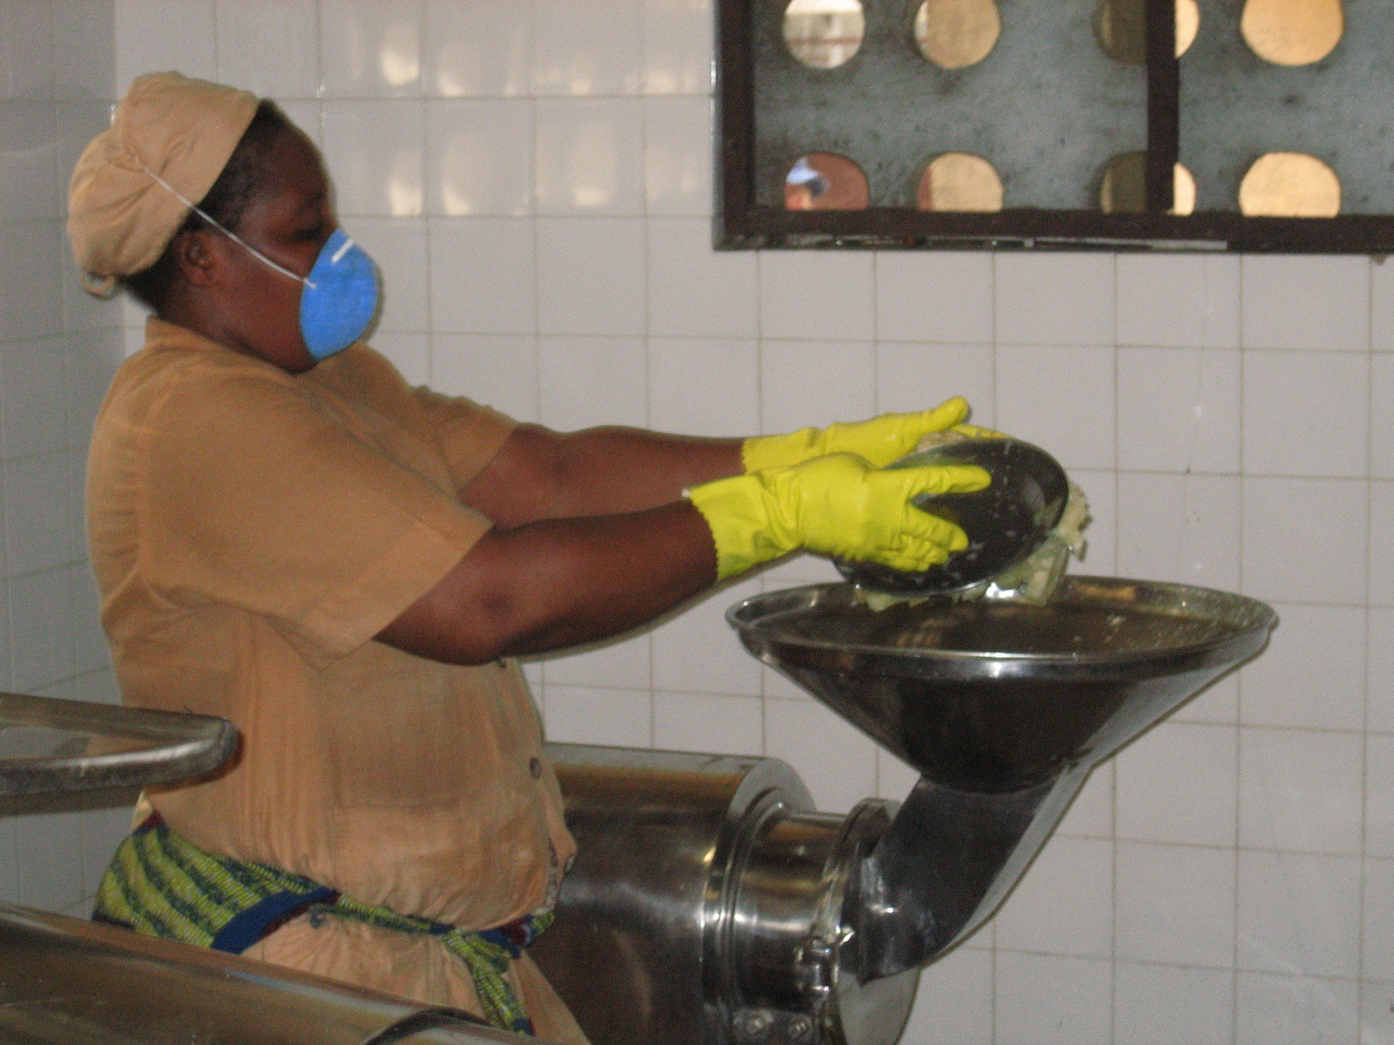
Much remains to be done. Join us!
Thank you for your time and interest.

